Slide 1
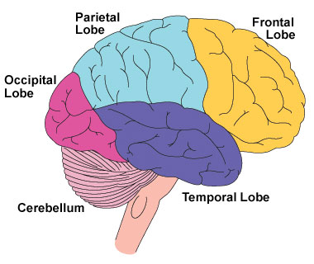
Brain Anatomy and Dysfunction
Brain Awareness Council
Wake Forest University
Graduate Program

Slide 2
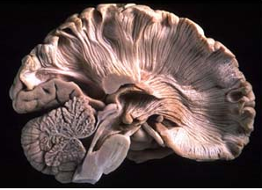
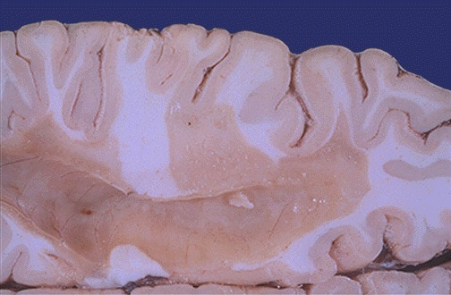
Myelin Multiple Sclerosis
Myelin is destroyed and neurons can’t communicate
Thought to be an autoimmune disorder
Above: dissection of a normal brain revealing the Corona Radiata. Right: an MS lesion.
Notes:
Ataxia means clumsy or lack of coordination. Cerebellar Ataxia is an umbrella term for disorders of the nervous system which cause unsteadiness and a lack of co-ordination.
There are genetic forms of the disease. Some genetic symptoms begin in teen years, others in mid-adulthood. In addition, some cerebellar ataxias can be caused by brain injury, viral infections or tumours.
Walking can become increasingly difficult if the ataxia progesses, and it may eventually become necessary to use a wheelchair. Other symptoms can include difficulties with swallowing and slurred speech. Sight and hearing can also be affected. In rare cases, they can be lost altogether. However, intellectual faculties are not affected.
There is currently no cure for people with cerebellar ataxia. However, there are medications available to relieve tremors and muscle spasms.

Slide 3
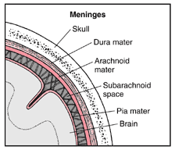
Meninges Meningitis
Infection in fluid surrounding the brain causes meninges to swell
Can be caused by bacteria or virus

Slide 4
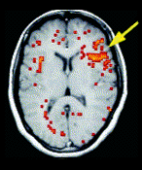
Cortex Epilepsy
Focal point of seizure activity
Seizures occur when neurons fire uncontrollably
Epilepsy is a condition of recurring seizures that may be caused by head trauma, tumor, stroke, infection, or genetics
Notes:
The meninges include the dura mater, arachnoid layer, pia mater. Meninges surround and protect the brain and spinal cord, they also hold fluid around the brain that helps absorb the impact when you are hit on the head.
Meningitis is an infection in the fluid around the brain that causes inflammation, or swelling, in the meninges. This can be caused by a virus or a bacteria, bacterial meningitis can be deadly. Common symptoms of meningitis include a high fever, headache, and stiff neck. Treatment includes IV antibiotics for a bacterial infection and medications to relieve the symptoms of viral meningitis.

Slide 5
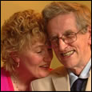
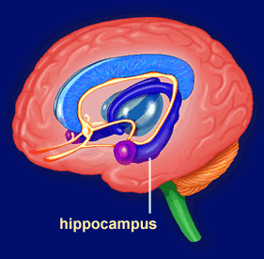
Temporal Lobe Hippocampus Amnesia
Clive Wearing, English musician, born 1938
Viral infection in 1985 damaged his hippocampus – caused anterograde amnesia
Memory span lasts about 30 seconds
Every conscious moment is like waking up for the first time in the last 20 years
Notes:
A Seizure happens when neurons in your brain start firing uncontrollably. If this activity is limited to a small area of the cortex (depending on which area) the person may not experience many symptoms. But if the seizure activity spreads, the seizure may cause convulsions or loss of consciousness. Seizures may be caused by head injury, fever, hypoglycemia (diabetes), brain tumors, drugs, or drug withdrawal. Epilepsy is an ongoing condition in which a person keeps having seizures.
Treatment includes medications (sedatives) or surgery, in the worst cases, to destroy or isolate the focal point of the seizure activity.

Slide 6
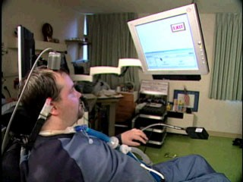
Parietal Lobe Motor Control
BrainGate – a strip of electrodes implanted on the motor cortex “reads” neuron activity
Motor neuron activity can control a cursor on a computer monitor
In 2004, Matthew Nagle, a quadriplegic, received this implant and was able to play video games by imagining he was moving his hand and arm
Notes:
There are two important parts to memory (explicit memory- things you can say you know): short-term and long-term memory. Short-term memory lasts seconds to minutes and long-term memory lasts for years. The hippocampus is a processing facility that converts short-term to long-term memories. Without it, you cannot make new long-term memories.
Clive Wearing, who is originally from England, was a musician and conductor until a viral infection damaged his hippocampus in 1985, when he was 46. He describes that every conscious moment is like waking up for the first time in the last 20 years. Sixty Minutes (Australia) Interview 2005: "[His life is like] one night 20 years long with no dreams and no thoughts. My brain has been totally inactive, day and night exactly the same. There's no difference between this and death." He has very limited memory of his life before the illness, but knows that he loves his wife dearly, and always wants her to come visit him He has no recollection of having seen her in 20 years. His memory span lasts about 30 seconds.
Similar cases of amnesia have affected characters in movies like Memento and 50 First Dates. In real life, people with this kind of amnesia are seriously handicapped and need 24-hour assisted living.

Slide 7
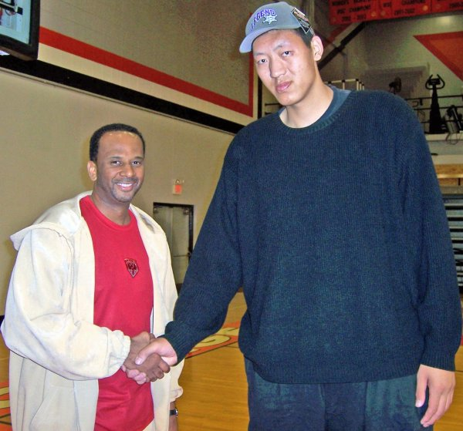
Pituitary Gland Gigantism
Pituitary gland controls release of hormones
A tumor on the pituitary gland may cause excessive release of growth hormone, causing gigantism or acromegaly
Sun Ming Ming, 7’9”, had pituitary tumor removed in 2005
Notes:
The neurons in the primary motor cortex control movement.
The technological company Cyberkinetics is developing a system called BrainGate. This system is being developed for people who are paralyzed or are losing muscle control (such as in Amyolateral Sclerosis). A small strip of electrodes that can measure the activity of neurons is implanted on top of the motor cortex. This is connected to a computer that can be programmed to read the neuron firing patterns when a person "thinks" about moving. This way, the person can learn to move a cursor on a computer screen just by thinking about moving.
In 2004, Matthew Nagle, a 25 year old man, was the first person to receive this type of implant. Matthew is a c4 quadriplegic who was paralyzed from the neck down after being stabbed in the neck. He needs a ventilator and can only move his head. With the BrainGate device implanted, he was able to play video games and check email by imagining he was moving his hand and arm. The device was taken out after a year because of FDA regulations, but similar clinical trials are ongoing.

Slide 8
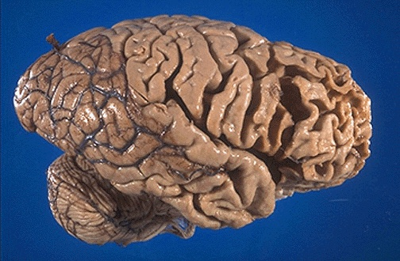
Frontal Lobes Pick’s Disease
Similar to Alzheimer’s Disease
Causes frontal lobe atrophy
Symptoms include impulsivity, poor decision-making, and dementia
Atrophy of frontal lobes caused by Pick’s Disease
Notes:
The Hypothalamus regulates blood pressure, electrolytes (thirst and craving for salt), body temperature, feeding and metabolism, reproduction, pregnancy, birth, lactation, stress response (fight or flight).
The pituitary gland controls endocrine release (hormones). A tumor on the pituitary gland may cause and excessive release of a particular hormone, like growth hormone. If this happens while a child is growing, he may develop gigantism. If this happens after puberty, it may cause a condition called acromegaly. Sun Ming Ming, 7'9" at age 22 (360 lbs) was diagnosed with acromegaly and had a pituitary tumor removed in Sept 2005 (at Baptist Hospital!). He just signed with the US basketball league Dodge City Legend, after training in Greensboro, NC in 2004.

Slide 9
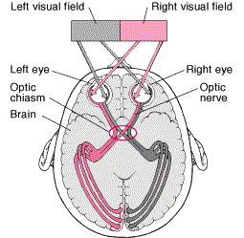


Optic Tract/ Occipital lobe Vision
Injury to the optic tract can cause hemianopia
Injury to the primary visual cortex can cause Blindsight
Normal vision
Vision with right hemianopia
Notes:
Pick's Disease is a rare disorder that causes the frontal and temporal lobes of the brain, which control speech and personality, to slowly atrophy. Pick's Disease (similar to Alzheimer’s disease) is the result of a build-up of protein in the affected areas of the brain. The accumulation of abnormal brain cells, known as Pick's bodies, eventually leads to changes in character, socially inappropriate behavior, and poor decision making. This progresses to a severe impairment in intellect, memory, and speech. Because the frontal lobes affect behavior and emotional response, people with Pick's Disease will usually show signs of changes in personality before they show evidence of dementia. This may begin as impulsiveness or a lack of inhibition.
Pick's Disease usually strikes adults between the ages of 40 and 60, and is slightly more common in women than in men. While the cause is still unknown, there is a strong genetic component: Frontotemporal Dementias tend to run in families, and approximately 40% of Pick's Disease cases are believed to be hereditary.

Slide 10
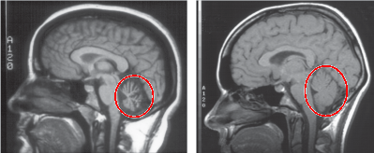
Cerebellum Cerebellar Ataxia
Impairs motor coordination
Can be caused by genetics, injuries, or infections
Brain with Cerebellar atrophy
Healthy brain
Notes:
Hemianopia is a blindness or reduction in vision in one half of the visual field due to damage of the optic pathways in the brain. This damage can result from acquired brain injuries caused by stroke, tumor or trauma.
The primary visual cortex may be damaged as the result of a stroke or injury, which can result in Blindsight. In this condition, people use visual information they get through their visual field even though they have no conscious awareness of being able to see anything. They can still locate objects (point to them or walk around them). Visual information from the optic nerve goes to the primary visual cortex and to the superior colliculus—part of the brain stem that helps you orient your eyes when you see something moving. This may be the part of the pathway responsible for blindsight. Another explanation is that perception is distributed throughout the brain—visual association areas are still working without the primary cortex.
(Fox News Oct 2005) "Tony Ro, a psychology professor at Rice University in Houston. Ro and his research team studied what could be sensed by volunteers who were temporarily blind. Their findings are reported Monday in the online edition of Proceedings of the National Academy of Sciences.
In the study, temporary, reversible blindness was induced in volunteers by using magnetic pulses that affected the visual cortex, the area in the back of the brain that processes what the eyes are seeing.
A computer screen was in front of the volunteers. In one test, during their momentary blindness the screen flashed with either a vertical or horizontal line. In a second test a red or green ball was shown on the screen. When the volunteers were asked what they had seen during the temporary blindness, they said they saw nothing, the researchers reported. But, the researchers said, when the patients were told to guess which way the line was oriented, they were right 75 percent of the time. And they got the color of the ball right 81 percent of the time. Random guessing would be expected to result in a 50 percent correct rate."

